Slide 1
OpenACC
Lab3

Slide 2
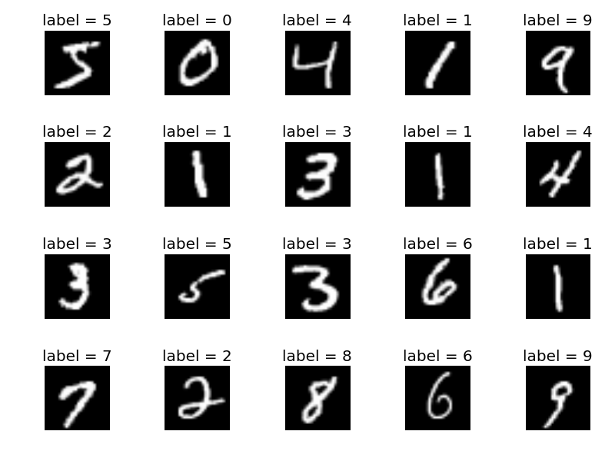
Deep Neural Network(DNN)
MNIST hand written digits classification Inference

Slide 3
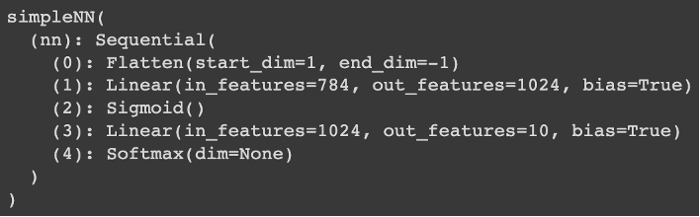
Deep Neural Network(DNN)
Two fully-connected layer

Slide 4
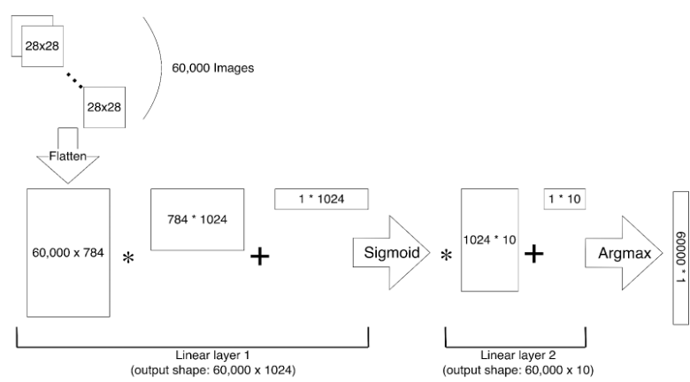
Deep Neural Network(DNN)
Two fully-connected layer

Slide 5
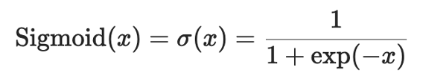
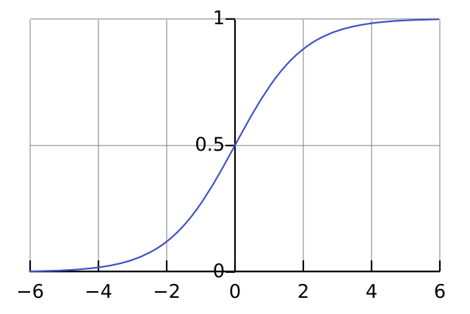
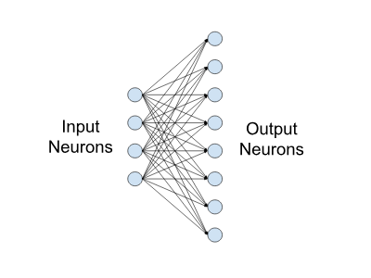
Deep Neural Network(DNN)
Two fully-connected layer
First Linear Layer + Sigmoid Activation Function
Second Linear Layer + Argmax

Slide 6
Task
Given the sequential version of DNN code that runs on CPU.
Try to parallel the matrix computation in the neural network.
Using OpenACC
The sequential code requires about 30~40 seconds

Slide 7
Task
Provided files:
Sequential code
pretrained model weights(since the task is inference)
Makefile
Please only modify the functions with TODO label.

Slide 8
Workflow
cp -r /home/pp24/share/lab-mnist ~/lab_mnist
cd ~/lab_mnist
module load nvhpc-nompi/24.9
Parallel the TODOs
compile the program : make
run the DNN program : srun --gres=gpu:1 ./mnist
judge: lab-mnist-judge
Scoreboard: mnist

Slide 9
Result
Inference accuracy should be 97.8183% (the parallelization should not affect the accuracy)

Slide 10
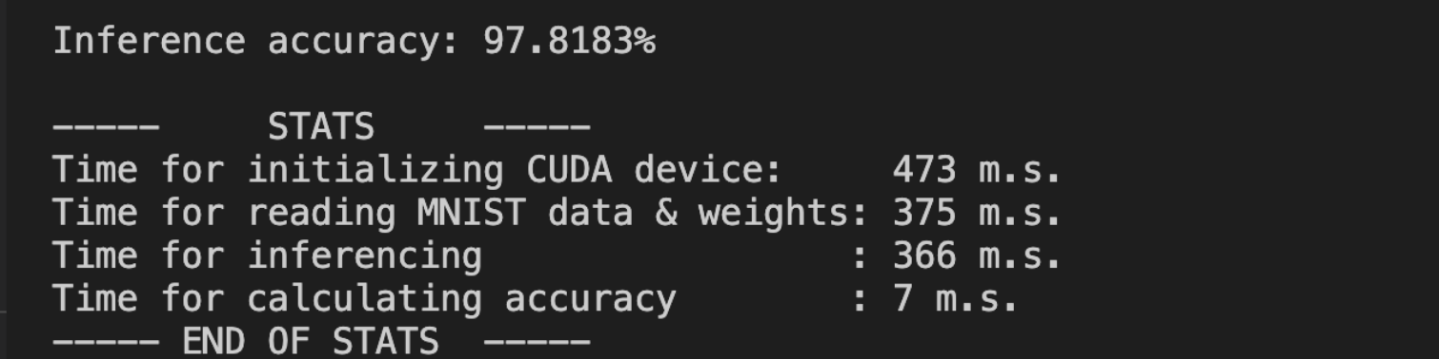
Result

Slide 11
Judge Result

Slide 12
Submission
Submit your code and Makefile (optional) to eeclass before 10/31 23:59
mnist.cpp
Makefile (Optional)

